Slide 1
CS 205
Artificial Intelligence

Slide 2
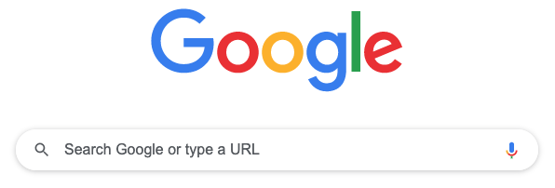
Search
Blind Search
Uniform Cost Search
Heuristic Search
Adversarial Search

Slide 3
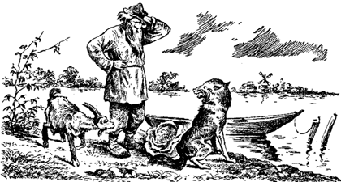
Let's play a game...
A farmer with his wolf, duck and bag of corn come to the east side of a river they wish to cross. There is a boat at the river's edge, but of course only the farmer can row. The boat can only hold two things (including the rower) at any one time. If the wolf is ever left alone with the duck, the wolf will eat it. Similarly if the duck is ever left alone with the corn, the duck will eat it. How can the farmer get across the river so that all four arrive safely on the other side?
Img Source: Wikipedia "Wolf, goat and cabbage problem"

Slide 4


Think-pair-share
Problem: move all FWDC across.
Rules: W eats D and D eats C without F. F always moves with at most one passenger.
Start: { FWDC | } Example move: { W C | F D }
Goal: { | FWDC }

Slide 5
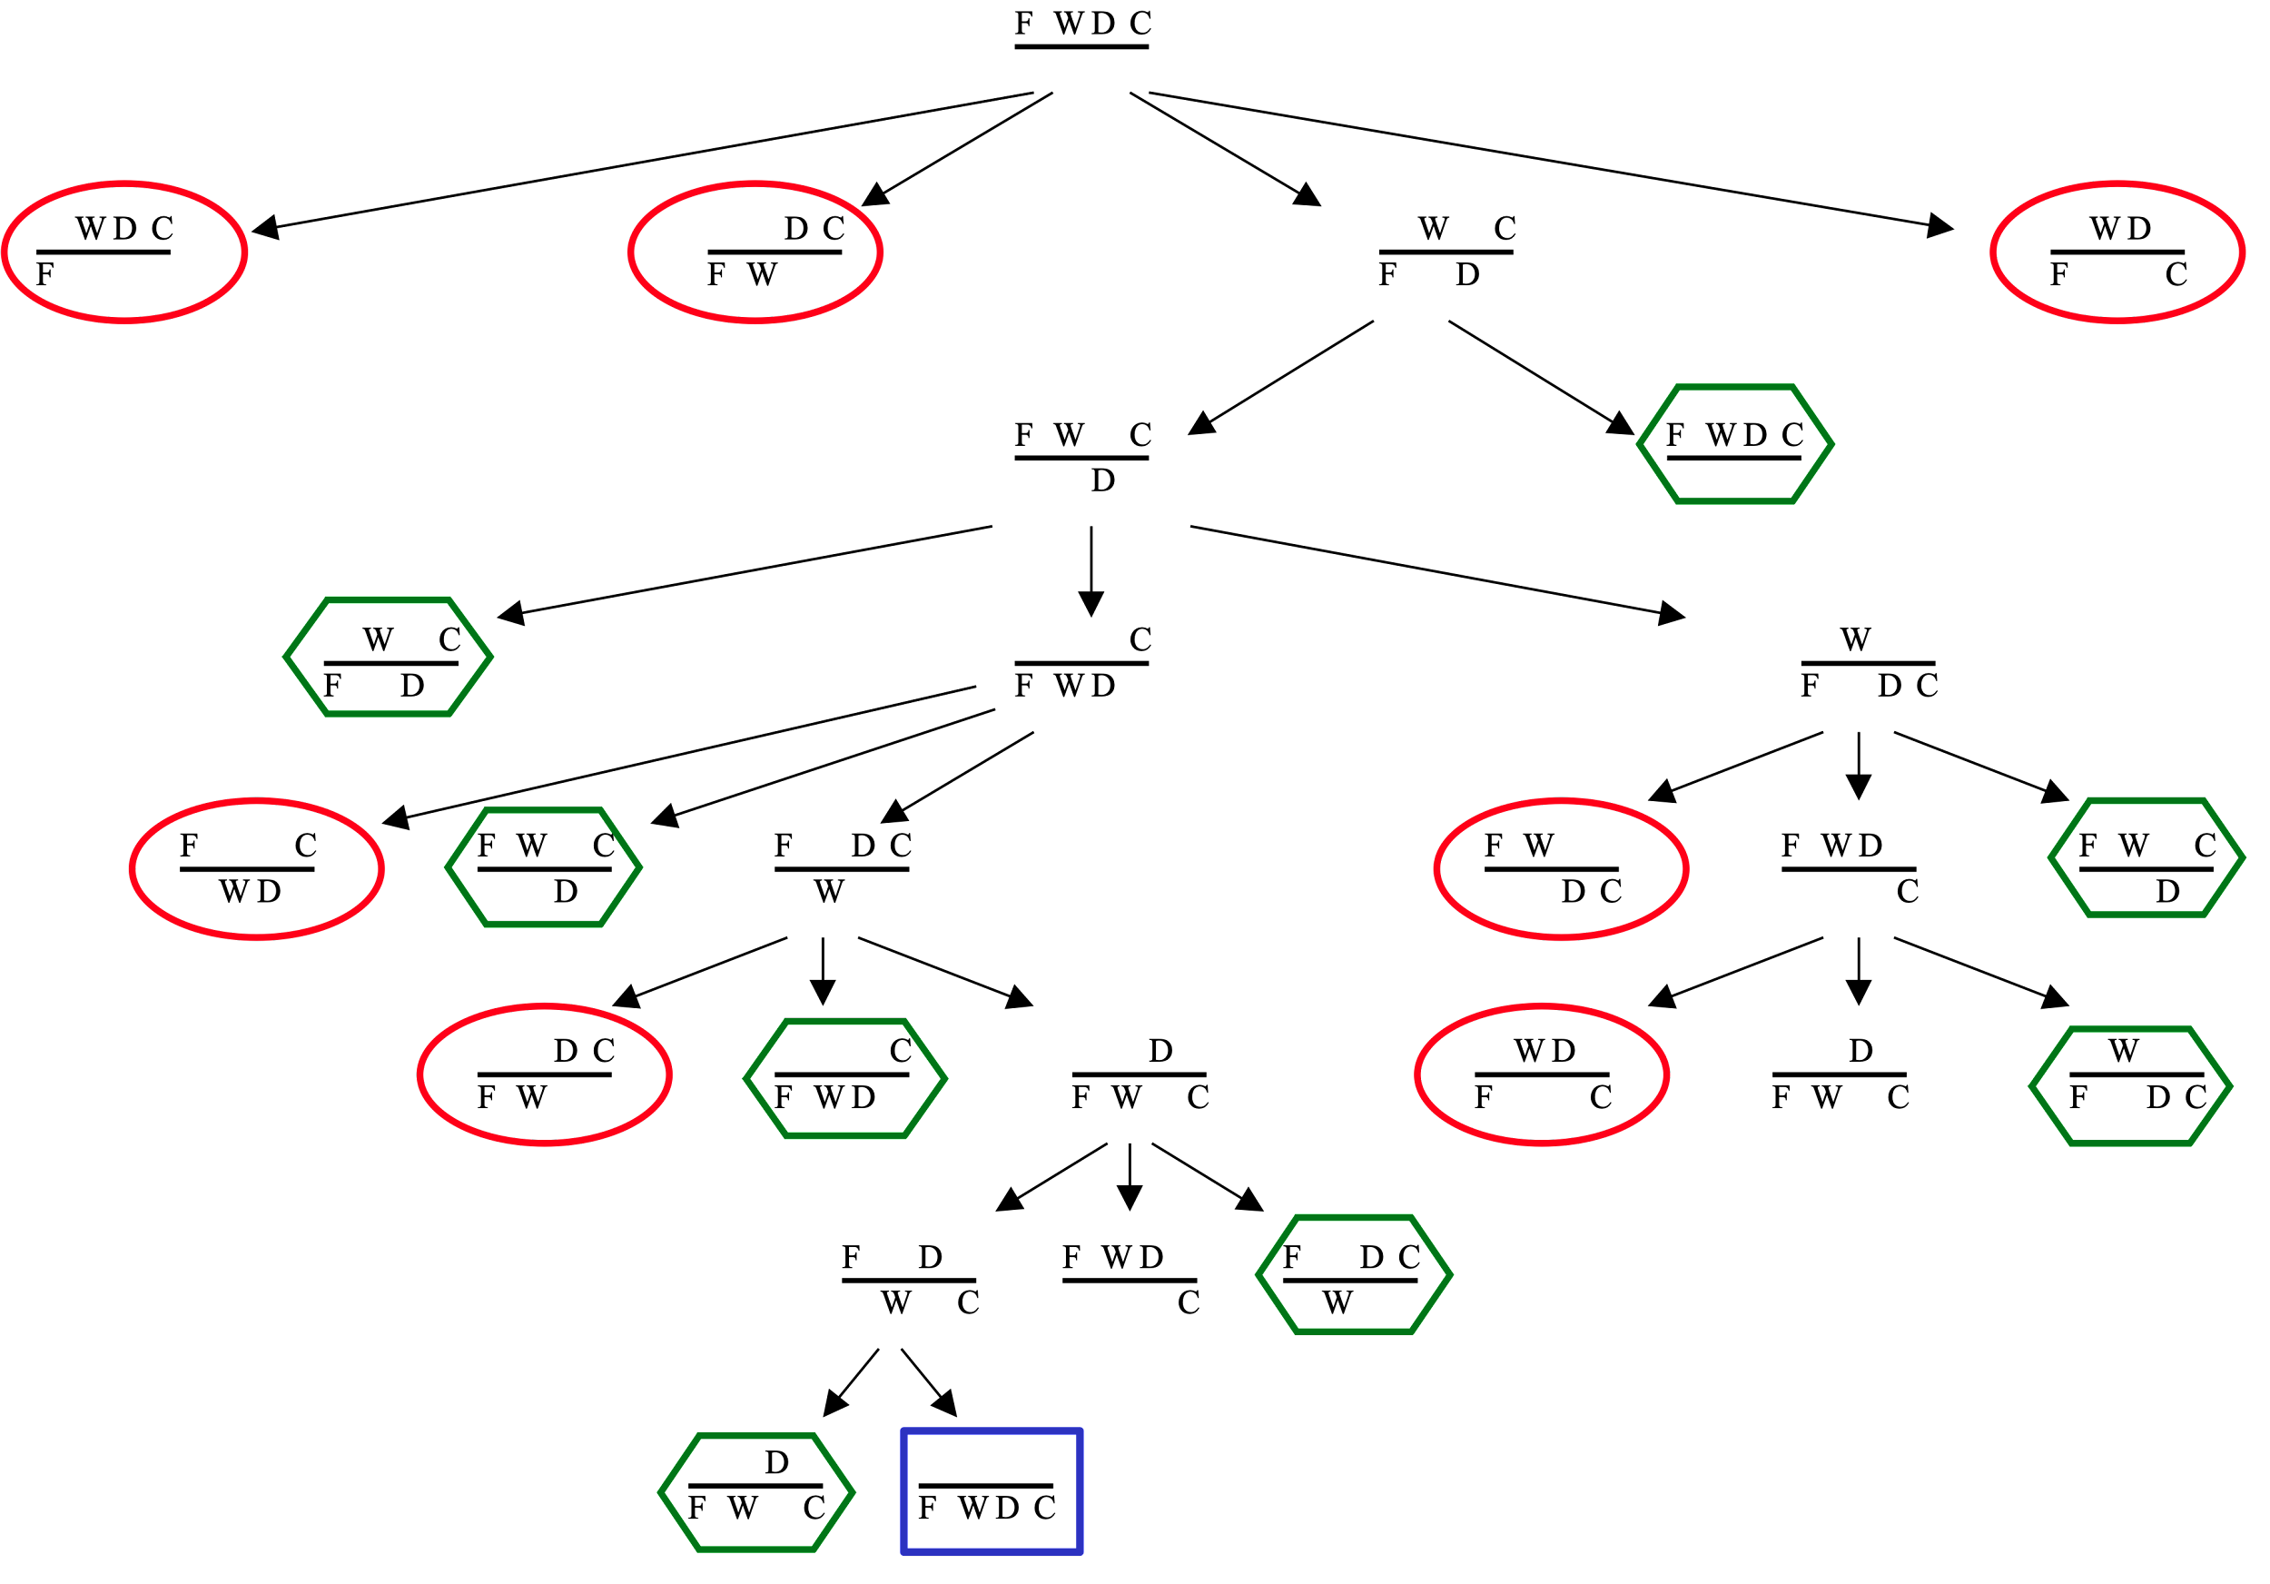
Search
States (initial, final)
Operations
Solution
goal state* or
path to goal state
* Constraint satisfaction problems do not require a path, just whether a solution exists.

Slide 6
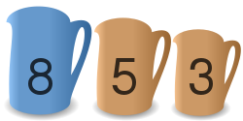
Let's play another game...
With three jugs of capacity 8, 5 and 3 liters, initially filled with 8, 0 and 0 liters, transfer the water so that we are left with 4, 4 and 0 liters.
Img Source: Wikipedia "Water pouring puzzle"

Slide 7
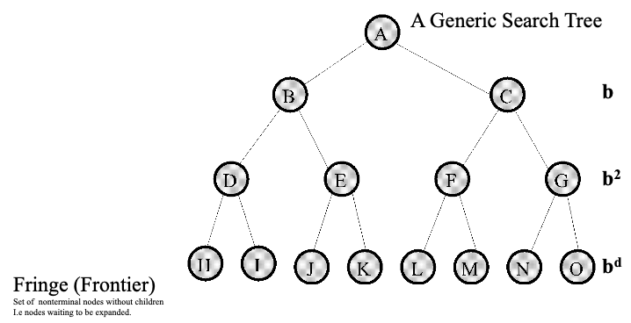
Search
Branching factor
Depth
Frontier

Slide 8
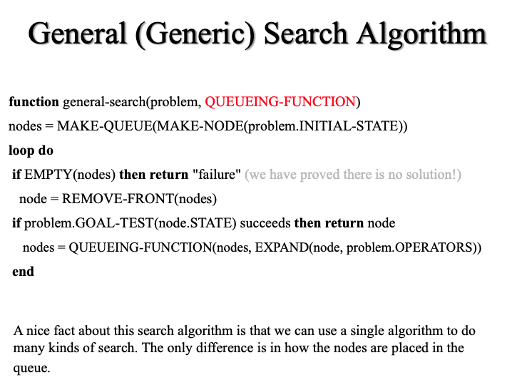

Search
Breadth-first — a queue
Depth-first — a stack

Slide 9
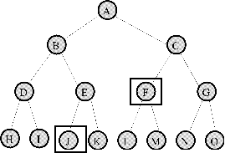
Search
Completeness: Is the technique guaranteed to find an answer (if there is one).
Optimality: Is the technique guaranteed to find the best answer (if there is more than one).
Time Complexity: How long does it take to find a solution.
Space Complexity: How much memory does it take to find a solution.

Slide 10
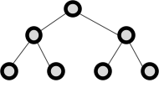
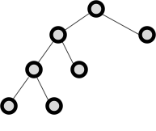
Search
Breadth-first Search:
complete, optimal
slow O(b^{d}), expensive O(b^{d})
Depth-first Search:
not complete, not optimal
fast O(b^{m}), cheap O(bm) m is max depth
what if...
I will get there...
dum dee dum...

Slide 11
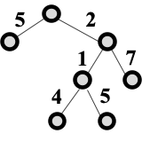
Search
Uniform Cost Search:
complete, optimal if nondecreasing cost
slow O(b^{d}), expensive O(b^{d})
Idea: expand cheapest node, where cost is path cost g(n).
Note: BFS is a special case of uniform cost search, where path cost is depth (each expansion costs 1).

Slide 12
Search
Depth-Limited Search:
complete, not optimal
faster O(b^{L}), cheaper O(bL) L is cutoff
Iterative Deepening Search:
complete, optimal
fast O(b^{d}), cheap O(bd) d is depth of sol.
I will get there...
L, stop!

Slide 13
Search
Blind Search
Uniform Cost Search
Heuristic Search
Adversarial Search
Let's take a look at Prof Eamonn's slides for a minute.

Slide 14
Paper Presentations!

Slide 15
Next time...
Heuristic Search, A*

